Slide 1


Word Embedding
Keras for Deep Learning Research

Slide 2
Feedback is greatly appreciated!

Slide 3
Overview
Overfitting
Dropout
Data augmentation
Callbacks
Word Embeddings (representation of text data)

Slide 4
Let's quickly review what we've covered so far!

Slide 5
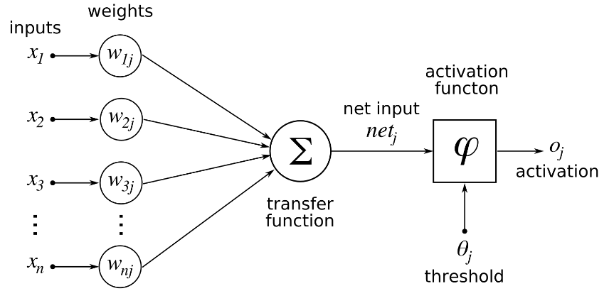
Deep Learning
Single Neuron
We now understand how to perform a calculation in a neuron
w · x + b = z
a = σ(z)
Source: https://www.udemy.com/complete-guide-to-tensorflow-for-deep-learning-with-python/learn/v4/overview

Slide 6
Deep Learning
Activation Functions
Threshold Function/Step Function
Sigmoid
Rectifier
Hyperbolic Tangent(tanh)
Source: https://www.udemy.com/complete-guide-to-tensorflow-for-deep-learning-with-python/learn/v4/overview

Slide 7
Deep Learning
Connecting Neurons to create a network
Neural Network
Input Layer
Hidden Layers
Output Layer
More layers → More Abstraction
Source: https://www.udemy.com/complete-guide-to-tensorflow-for-deep-learning-with-python/learn/v4/overview

Slide 8
Deep Learning
To "learn" we need some measurement of error.
We use a Cost/Loss Function
Quadratic
Cross-Entropy
Hinge Loss
Source: https://www.udemy.com/complete-guide-to-tensorflow-for-deep-learning-with-python/learn/v4/overview

Slide 9
Deep Learning
Once we have the measurement of error, we need to minimize it by choosing the correct weight and bias values.
We use gradient descent to find the optimal values.
Source: https://www.udemy.com/complete-guide-to-tensorflow-for-deep-learning-with-python/learn/v4/overview

Slide 10
Deep Learning
We can then backpropagate the gradient descent through multiple layers, from the output layer back to the input layer.
Source: https://www.udemy.com/complete-guide-to-tensorflow-for-deep-learning-with-python/learn/v4/overview

Slide 11
Arguably, Machine Learning models have one sole purpose; to generalize well
Generalization is the model’s ability to give sensible outputs to sets of input that it has never seen before

Slide 12

Underfitting / Good Fitting / Overfitting
Bias is the simplifying assumptions made by the model to make the target function easier to approximate.
Variance is the amount that the estimate of the target function will change given different training data.
Trade-off is tension between the error introduced by the bias and the variance.
https://www.geeksforgeeks.org/underfitting-and-overfitting-in-machine-learning/
https://machinelearningmastery.com/gentle-introduction-to-the-bias-variance-trade-off-in-machine-learning/

Slide 13
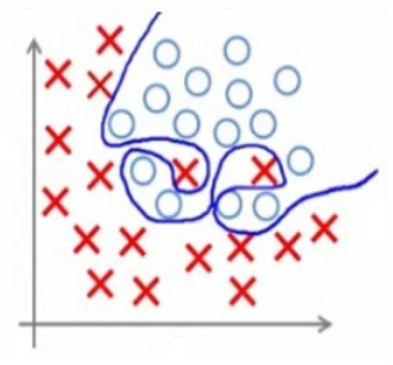
Overfitting
Overfitting is the case where the overall cost is really small, but the generalization of the model is unreliable.
This is due to the model learning “too much” from the training data set.

Slide 14
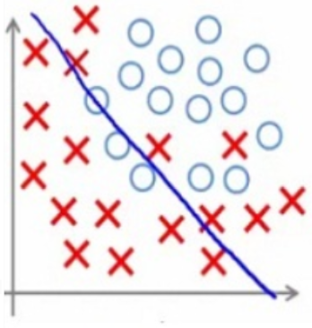
Underfitting
when a machine learning model is not complex enough to accurately capture relationships between a dataset’s features and a target variable

Slide 15
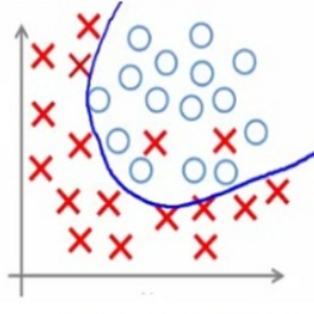
Best fitted

Slide 16
Underfitting / Overfitting / Good Fitting
Underfitting happens when the model cannot capture the underlying trend of the data.
Happens when you have less data.
While building a linear model with a non-linear data.
Overfitting happens when the model the model or the algorithm fits the data too well (too much patterns & noise captured).
Happens when the model is too complex.
Both overfitting and underfitting lead to poor predictions on new data sets.
https://www.geeksforgeeks.org/underfitting-and-overfitting-in-machine-learning/

Slide 17
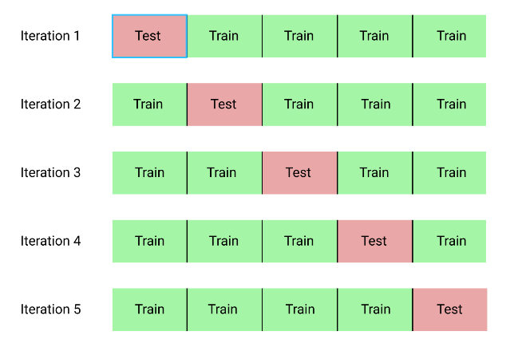
How to overcome it?
Cross-validation (K-fold cross validation)
Train with more data
Early stopping (mostly in deep learning model)
Regularization:
Regularization refers to a broad range of techniques for artificially forcing your model to be simpler.
The method will depend on the type of learner you’re using.
For example, you could prune a decision tree,
use dropout on a neural network,
or add a penalty parameter to the cost function in regression
Ensembling

Slide 18
Preventing Overfitting
Standard ways to limit the capacity of a neural net:
Limit the number of hidden units.
Limit the size of the weights.
Stop the learning before it has time to overfit.
G. Hinton, 2006

Slide 19



Dropout
Training:
Each time before updating the parameters
Each neuron has p% to dropout

Slide 20


Dropout
Training:
Thinner!
Each time before updating the parameters
Each neuron has p% to dropout
The structure of the network is changed.
Using the new network for training
For each mini-batch, we resample the dropout neurons

Slide 21






Dropout - Intuitive Reason
When teams up, if everyone expect the partner will do the work, nothing will be done finally.
However, if you know your partner will dropout, you will do better.

Slide 22



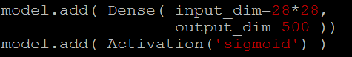









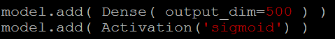


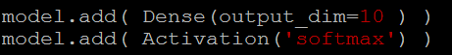
Let’s try it
……
500
……
model.add( dropout(0.5) )
500
……
model.add( dropout(0.7) )
Softmax
y₁
y₂
^{y}10
……

Slide 23
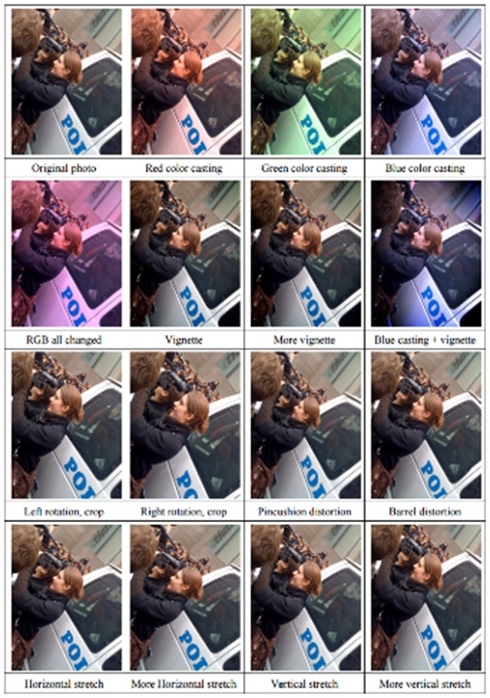
Data Augmentation (Jittering)
Create virtual training samples
Horizontal flip
Random crop
Color casting
Geometric distortion
Deep Image [Wu et al. 2015]

Slide 24
Programming

Slide 25
callbacks
A callback is a set of functions to be applied at given stages of the training procedure
You can use callbacks to get a view on internal states and statistics of the model during training
keras.callbacks.Callback()

Slide 26
callbacks
History
ModelCheckpoint
EarlyStopping
TensorBoard
ReduceLROnPlateau

Slide 27
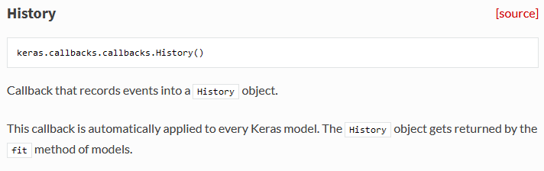
History
https://keras.io/callbacks/#history

Slide 28
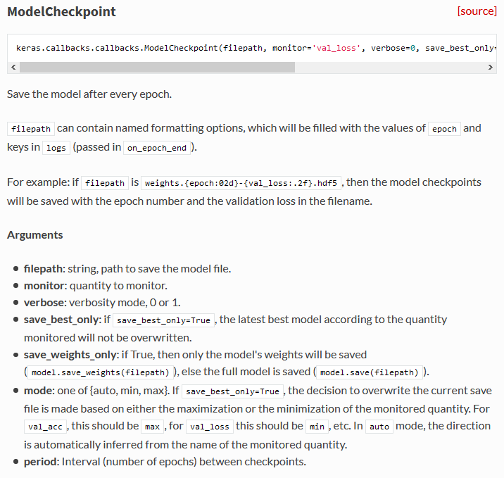
ModelCheckpoint
https://keras.io/callbacks/#modelcheckpoint
Save the model after every epoch.
keras.callbacks.ModelCheckpoint(filepath, monitor='val_loss', verbose=0,
save_best_only=False, save_weights_only=False, mode='auto')

Slide 29
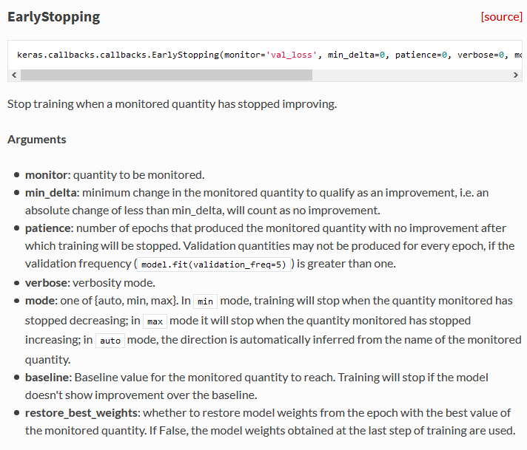
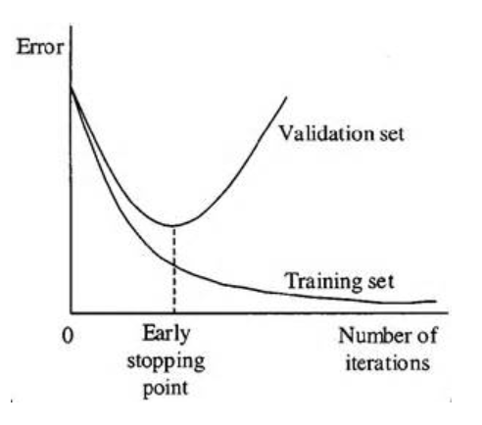
Early Stopping
https://keras.io/callbacks/#earlystopping
Stop training when a monitored quantity has stopped improving.
keras.callbacks.EarlyStopping(monitor='val_loss', min_delta=0,
patience=0, verbose=0, mode='auto', baseline=None,
restore_best_weights=False)

Slide 30
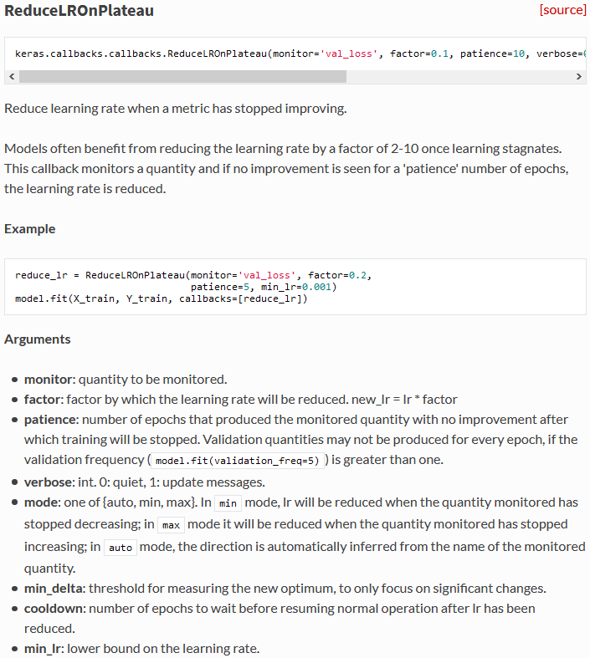
ReduceLROnPlateau
https://keras.io/callbacks/#reducelronplateau

Slide 31
Tensorboard
Tensorflow, the deep learning framework from Google comes with a great tool to debug
It hosts a website on your local machine in which you can monitor things like accuracy, cost functions
and visualize the computational graph that Tensorflow is running based on what you defined in Keras
Pip install tensorboard

Slide 32
Tensorboard https://keras.io/callbacks/#tensorboard
tensorboard = TensorBoard(log_dir="logs/{}".format(time())) model.fit(x_train, y_train, verbose=1, callbacks=[tensorboard])
You need to create a new TensorBoard instance and point it to a log directory where data should be collected.
Next you need to modify the fit call so that it includes the tensorboard callback.
Then the following command in the separate terminal
tensorboard --logdir=logs/
http://localhost:6006/

Slide 33
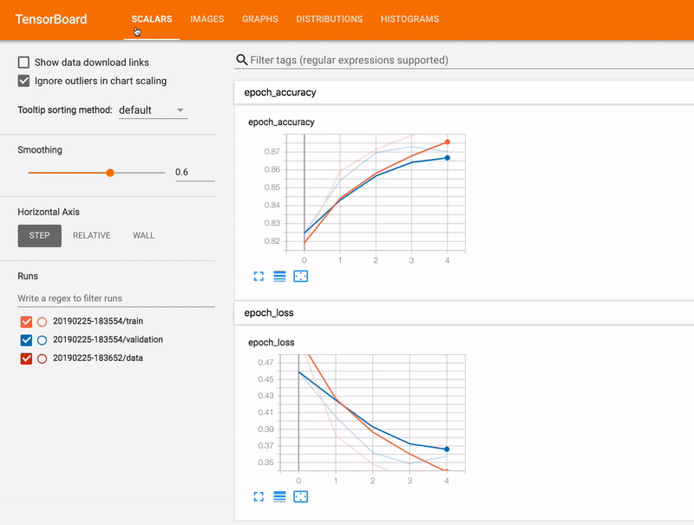
Tensorboard

Slide 34
Word Embedding

Slide 35
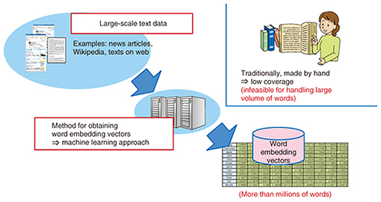
Why Word Embeddings: Essential for text processing with DL
It is an essential part of text processing with Deep Learning because Machine Learning algorithms, and almost all Deep Learning architectures, are incapable of processing strings or plain text in their raw form.
TEXT processing
Source: https://www.analyticsvidhya.com/blog/2017/06/word-embeddings-count-word2veec/
https://www.ntt-review.jp/archive/ntttechnical.php?contents=ntr201711fa4.html

Slide 36
Types of Word Embeddings
Word embeddings can be broadly classified into two categories
Frequency based Embedding
Count Vector
TF-IDF Vector
Co-Occurrence Vector
Prediction based Embedding
Word2vec: (https://arxiv.org/pdf/1301.3781.pdf)
CBOW (Continuous Bag of words)
Skip-Gram Model
GloVe: Global Vectors for Word Representation
Source: https://www.analyticsvidhya.com/blog/2017/06/word-embeddings-count-word2veec/

Slide 37
Why do we use word embeddings in NLP?
Natural language processing (NLP) is a sub-field of machine learning (ML)
often in the form of text, which is itself composed of smaller units like words and characters
Dealing with text data is problematic, since our computers, scripts and machine learning models can’t read and understand text in any human sense

Slide 38
So, how should textual input be sent to our models?
Computers can handle numerical input well, so let’s rephrase the question to:
How can we best numerically represent textual input?

Slide 39
Word Embedding
Why do we need any complex methods to represent words at all?
What is the simplest way to represent words numerically, and why isn’t this sufficient?
What exactly do we mean by embeddings “mapping words to a high-dimensional semantic space”?
How can word embeddings be visualized and intuitively understood?

Slide 40

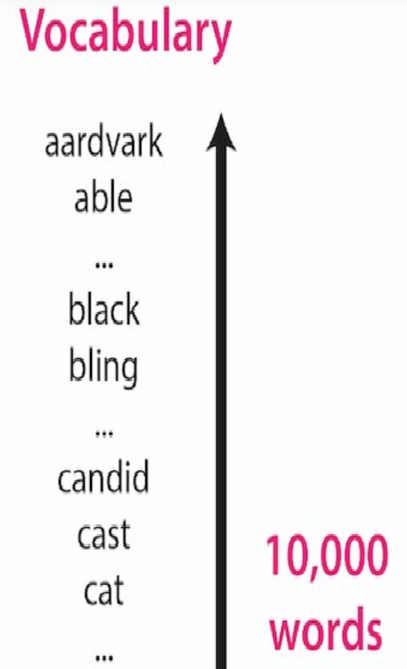
A world without word embeddings
Given this vocabulary of 10,000 words, what’s the simplest way to represent each word numerically?

Slide 41
Well, you could simply assign an integer index to each word:
Given this word-to-integer mapping, we could then represent a word as a vector of numbers as follows:
Each word will be represented as an n-dimensional vector, where n is the vocabulary size
Each word’s vector representation will be mostly “0”, except there will be a single “1” entry in the position corresponding to the word’s index in the vocabulary.

Slide 42
One-Hot encoding
The vector representation for our first vocabulary word “aardvark” will be [1, 0, 0, 0, …, 0], which is a “1” in the first position followed by 9,999 zeroes.
This process is called one-hot vector encoding.

Slide 43
Now, say our NLP project is building a translation model and we want to translate the English input sentence “the cat is black” into another language.
We first need to represent each word with a one-hot encoding
We would first look up the index of the first word, “the”, and find that its index in our 10,000-long vocabulary list is 8676.

Slide 44
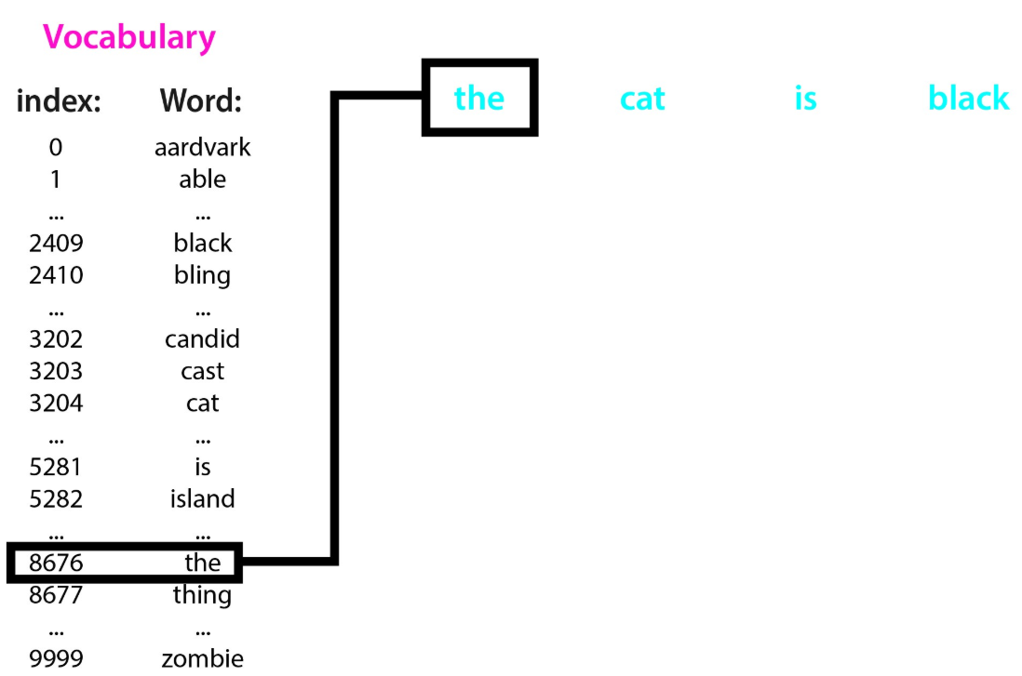
We could then represent the word “the” using a length 10,000 vector, where every entry is a 0 aside from the entry at position 8676, which is a 1.
We do this index look-up for every word in the input sentence, and create a vector to represent each input word.
These one-hot vectors are a quick and easy way to represent words as vectors of real-valued numbers.

Slide 45
The problems with sparse one-hot encodings
One-hot vectors are high-dimensional and sparse
Feature vector grows with the vocabulary size
Semantic and syntactic information are lost
The computational issue.

Slide 46
Idea behind Word Embedding
the core idea is that words that are used in similar contexts will be given similar representations.
That is, words that are used in similar ways will be placed close together within the high-dimensional semantic space–these points will cluster together, and their distance to each other will be low.

Slide 47
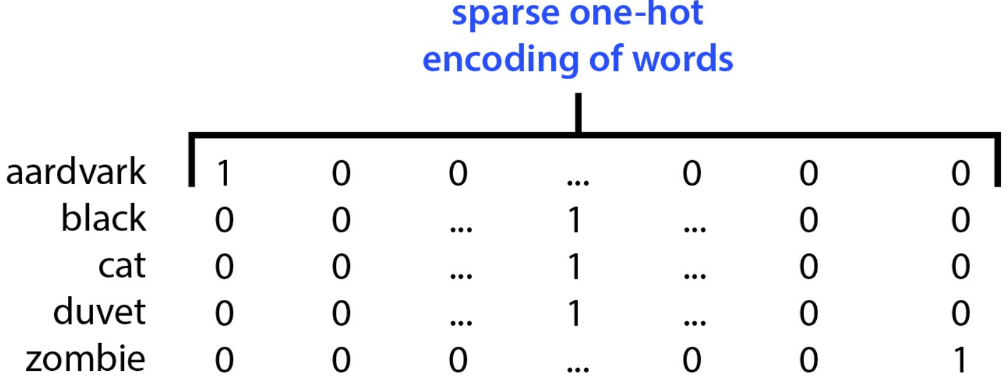
Example on one hot encoding

Slide 48
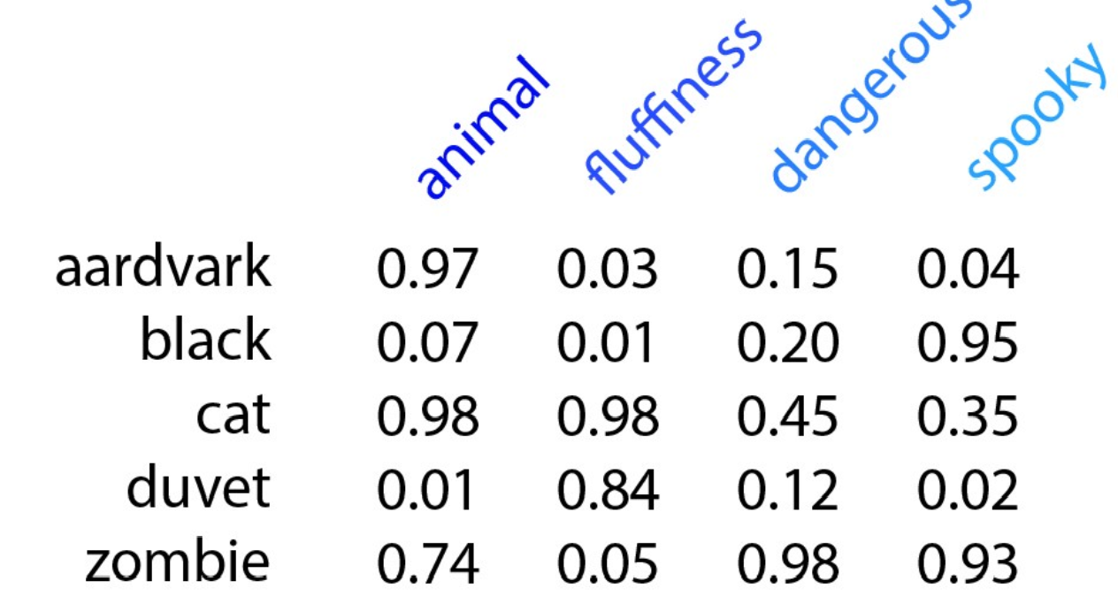
Equivalent Word embedding

Slide 49
Types of Word Embeddings
Word embeddings can be broadly classified into two categories
Frequency based Embedding
Count Vector
TF-IDF Vector
Co-Occurrence Vector
Prediction based Embedding
word2vec
CBOW (Continuous Bag of words)
Skip-Gram Model
GloVe: Global Vectors for Word Representation
Source: https://www.analyticsvidhya.com/blog/2017/06/word-embeddings-count-word2veec/

Slide 50
Two different architecture for word2vec
CBOW:
The input to the model is the preceding and following words of the current word
The output of the neural network will be Wi
Skip-gram:
The input to the model is wi and
The output is the words around it

Slide 51
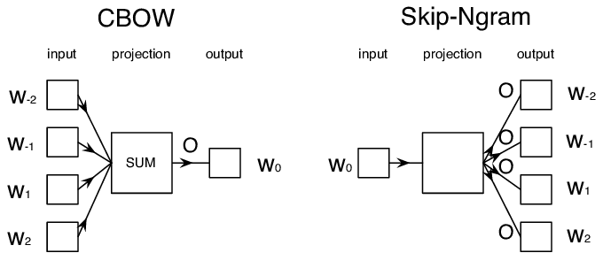
Two different architecture for word2vec
https://www.researchgate.net/figure/Illustration-of-the-Skip-gram-and-Continuous-Bag-of-Word-CBOW-models_fig1_281812760

Slide 52
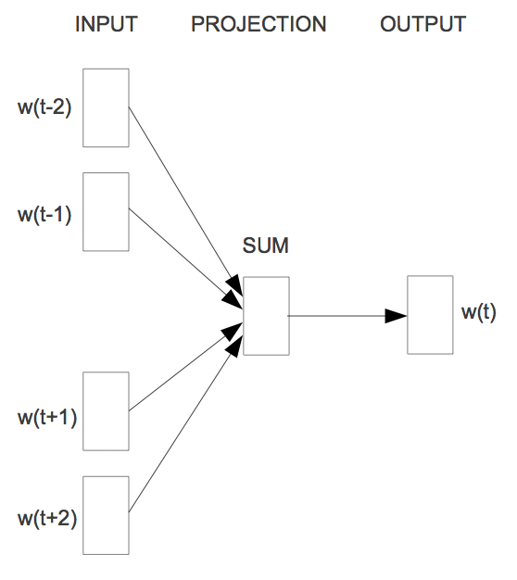
Word2vec - CBOW (Continuous Bag of words)
The way CBOW work is that it tends to predict the probability of a word given a context.
Let us start with an example (Tweet):
"When your dream becomes reality"
One approach is to treat ("When", "your", "becomes", "reality“) as a context and from these words, be able to predict or generate the center word "dream".
When
your
dream
becomes
reality
window size: 5
Source: https://www.analyticsvidhya.com/blog/2017/06/word-embeddings-count-word2veec/

Slide 53
Word2vec - CBOW (Continuous Bag of words)
Advantages of CBOW:
Being probabilistic is nature, it is supposed to perform superior to deterministic methods(generally).
It is low on memory. It does not need to have huge RAM requirements like that of co-occurrence matrix where it needs to store three huge matrices.
Disadvantages of CBOW:
CBOW takes the average of the context of a word (as seen above in calculation of hidden activation). For example, Apple can be both a fruit and a company but CBOW takes an average of both the contexts and places it in between a cluster for fruits and companies.
Training a CBOW from scratch can take forever if not properly optimized.
Source: https://www.analyticsvidhya.com/blog/2017/06/word-embeddings-count-word2veec/

Slide 54
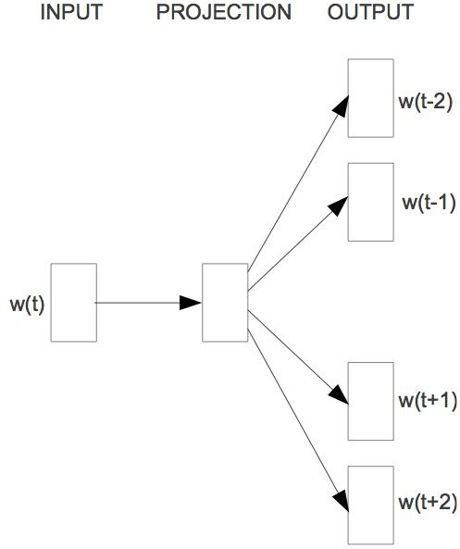
Word2vec - Skip-Gram Model
The aim of skip-gram is to predict the context given a word.
Let us check with same example (Tweet):
"When your dream becomes reality"
The approach is to create a model such that given the center word "dream", the model will be able to predict or generate the surrounding words ("When", "your", "becomes", "reality"). Here we call the word "dream" the context.
When
your
dream
becomes
reality
window size: 5
Source: https://www.analyticsvidhya.com/blog/2017/06/word-embeddings-count-word2veec/

Slide 55
Word2Vec Skip-gram model
Advantages of Skip-Gram Model
Skip-gram model can capture two semantics for a single word. i.e it will have two vector representations of Apple. One for the company and other for the fruit.
Skip-gram with negative sub-sampling outperforms every other method generally.
Source: https://www.analyticsvidhya.com/blog/2017/06/word-embeddings-count-word2veec/

Slide 56
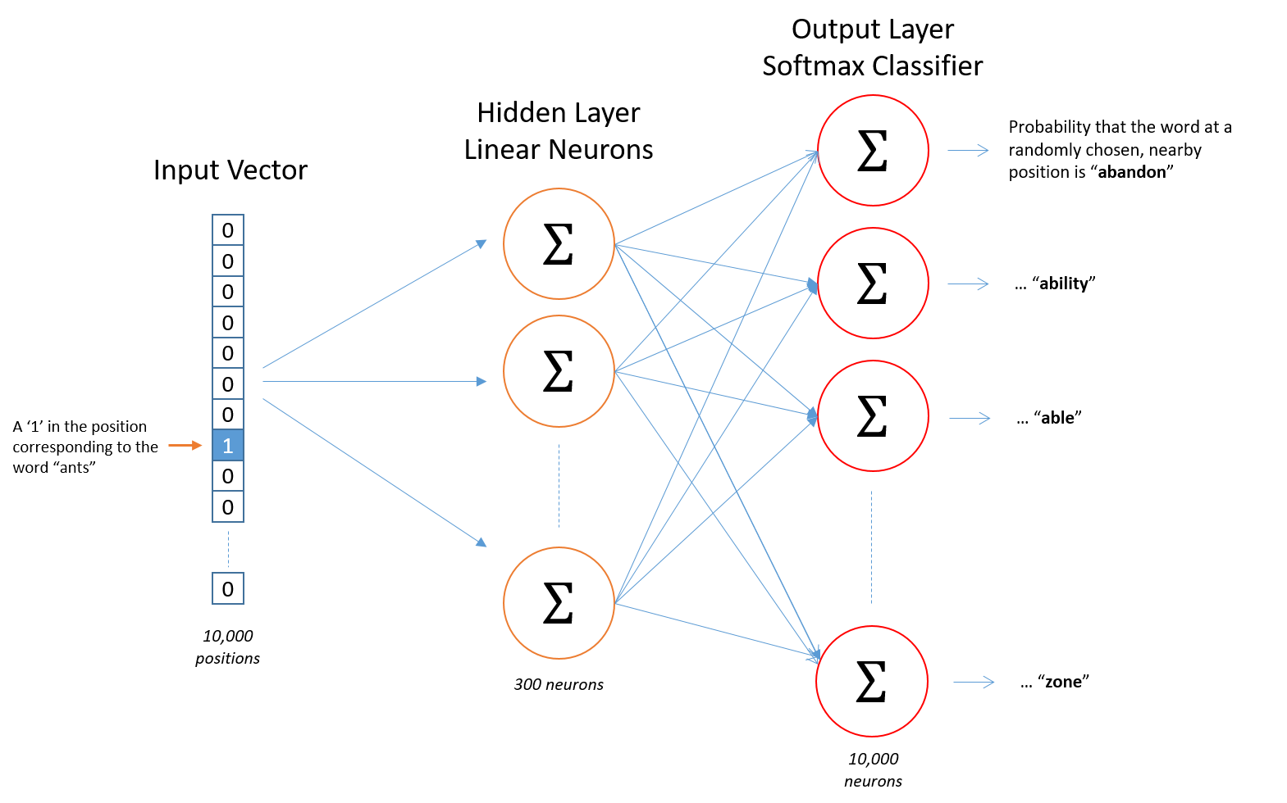
word2vec. skip-gram model
http://mccormickml.com/2016/04/19/word2vec-tutorial-the-skip-gram-model/

Slide 57
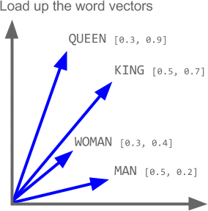
Properties of word2vec

Slide 58
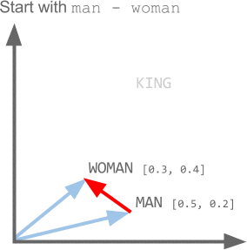

Slide 59
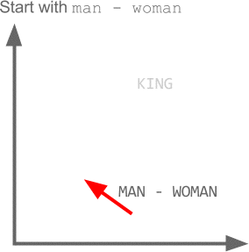

Slide 60
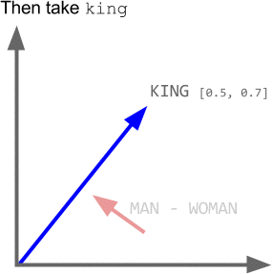

Slide 61
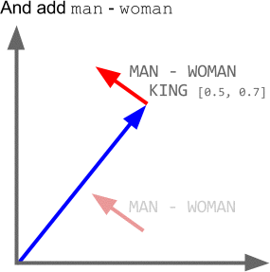

Slide 62
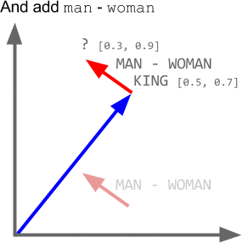

Slide 63
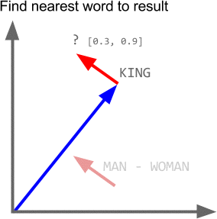

Slide 64
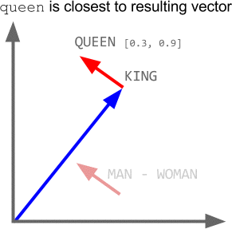

Slide 65
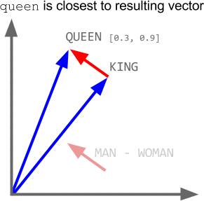

Slide 66
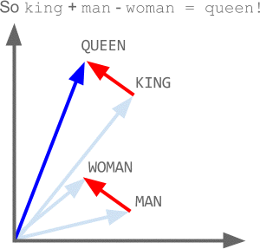

Slide 67
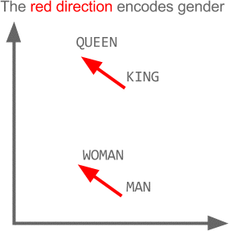

Slide 68
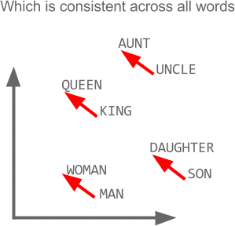

Slide 69
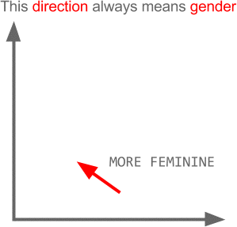

Slide 70
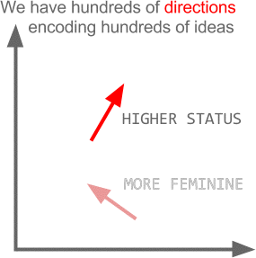

Slide 71
Programming

Slide 72
Embedding layer in Keras
input_dim: This is the size of the vocabulary in the text data.
For example, if your data is integer encoded to values between 0-10, then the size of the vocabulary would be 11 words.
output_dim: This is the size of the vector space in which words will be embedded. It defines the size of the output vectors from this layer for each word. For example, it could be 32 or 100 or even larger.
input_length: This is the length of input sequences, as you would define for any input layer of a Keras model. For example, if all of your input documents are comprised of 1000 words, this would be 1000.

Slide 73
Embedding layer in Keras
Preparing data for embedding layer:
Adding embedding layer in keras:
max_review_len = max([len(s.split()) for s in sentences]) vocab_size = len(tokenizer.word_index)+1 sentences = tokenizer.texts_to_sequences(sentences) padded_docs = pad_sequences(sentences,maxlen=max_review_len)
model.add(Embedding(vocab_size, 50, input_length=max_review_len))

Slide 74
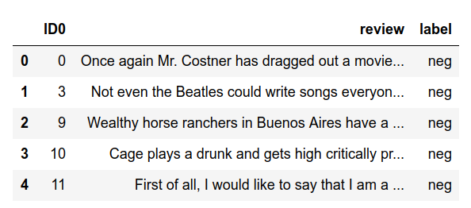
Use case: Sentiment Classification, IMDB dataset

Slide 75
Reading the data
df = pd.read_csv('imdb_master.csv',encoding='latin-1') sentences = df['review'].values y = df['label'].values

Slide 76
Steps to prepare the text data (review column)
Keras provides the Tokenizer class for preparing text documents for deep learning.
The Tokenizer must be constructed and then fit on either raw text documents or integer encoded text documents.
tokenizer = Tokenizer(num_words=2000) tokenizer.fit_on_texts(sentences)

Slide 77
Encoding the target column
le = preprocessing.LabelEncoder() y = le.fit_transform(y)

Slide 78
Creating and fitting the model
What is input_dim here?
model = Sequential() model.add(layers.Dense(300,input_dim=input_dim, activation='relu’))
model.add(layers.Dense(5, activation='sigmoid')) model.compile(loss='sparse_categorical_crossentropy',optimizer='adam',metrics=['acc']) model.fit(X_train,y_train, epochs=5, verbose=True, validation_data=(X_test,y_test), batch_size=256)
Is this number of neurons for the last layer is correct?
Is this activation function for the last layer is correct?

Slide 79
References
https://deeplearning4j.org/word2vec.html
https://towardsdatascience.com/tagged/word2vec
https://medium.com/@Aj.Cheng/word2vec-3b2cc79d674
https://medium.com/tag/word2vec
https://www.analyticsvidhya.com/blog/2017/06/word-embeddings-count-word2veec/
http://mccormickml.com/2016/04/19/word2vec-tutorial-the-skip-gram-model/
https://becominghuman.ai/how-does-word2vecs-skip-gram-work-f92e0525def4

